Slide 1
Coursera Capstone Project — the Battle of Neighbourhoods

Slide 2
PROBLEM & BACKGROUND
Toronto and New York are the famous places in the world. They are diverse in many ways. Both are multicultural as well as the financial hubs of their respective countries. We want to explore how much they are similar or dissimilar in aspects from a tourist point of view regarding food, accommodation, beautiful places, and many more.
Today Tourism is one of the pillars of the economy and the people most often visits those countries who are rich in heritage and developed enough from a foreign prospective, like friendly environment. Every city is unique in their own way and give something new. And now the information is so common regarding location of every place around the world on your fingertips which make it easier to explore. Therefore, tourists always eager to travel to different places on the basis of available information, and the comparison (the part of the information) between the two cities always assist to choose the specific places or according to their choice

Slide 3
Description In this project, we will study in details the area classification using Foursquare data and machine learning segmentation and clustering. The aim of this project is to compare two big cities: Ney York and Toronto. I will show, using segmentation and classification, the common features and difference between them.

Slide 4
Data
A list the all the boroughs and neighborhoods of Toronto and New York (with latitude and longitude data)
Foursquare neighborhood data that can be clustered

Slide 5
Methodology
As we have selected two cities Borough to explore their neighborhoods. The data exploration, analysis and visualization for both boroughs are done in the same way but separately

Slide 6
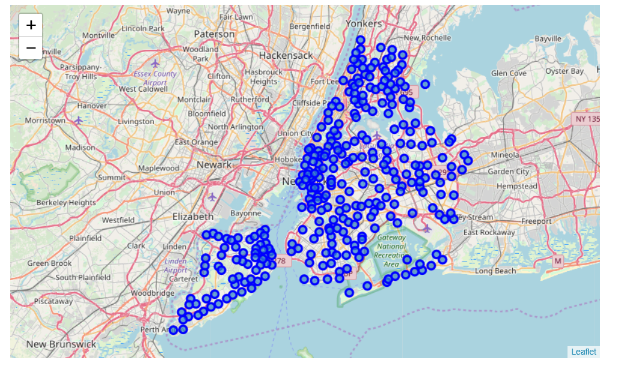
New York

Slide 7
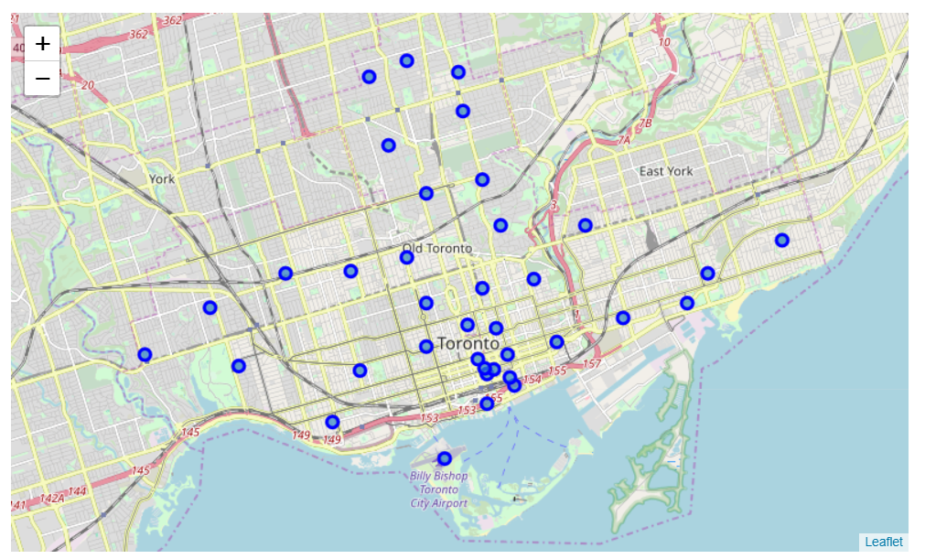
Toronto

Slide 8
ANALYSIS
We analyze both boroughs neighborhoods through one hot encoding (giving ‘1’ if a venue category is there, and ‘0’ in case of venue category is not there). On the basis of one hot encoding, we calculate mean of the frequency of occurrence of each category and picked top ten venues on that basis for each neighborhood. It means the top venues are showing the foot traffic or the more visited places.

Slide 9
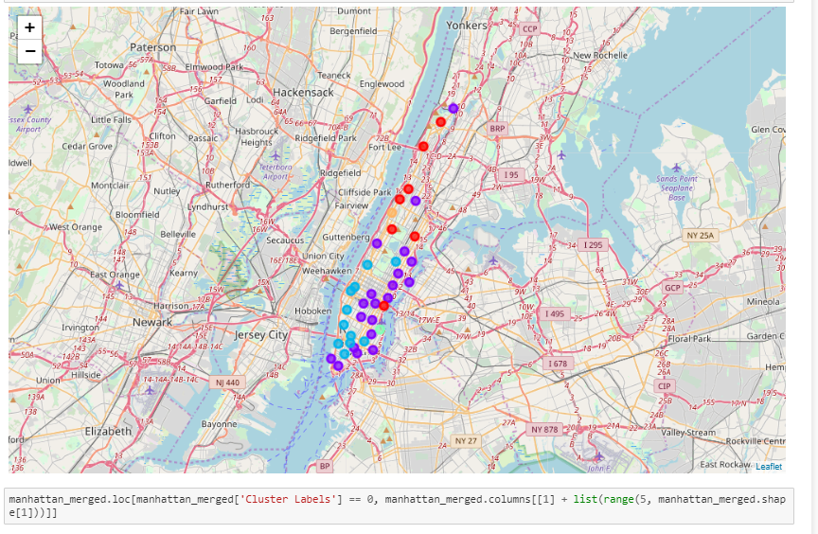
New York

Slide 10
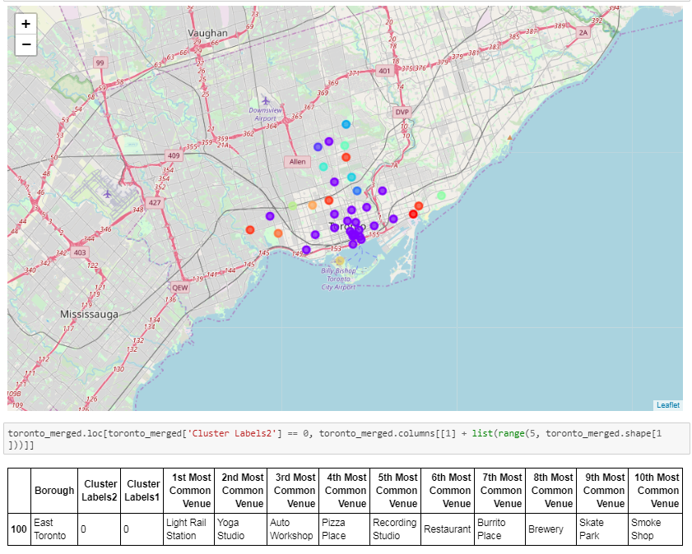
Toronto

Slide 11
RESULTS
After clustering the data of the respective neighborhoods, both cities (Boroughs) have venues which can be explored and attract the Tourists. The neighborhoods are much similar in features like Theaters, opera houses, food places, clubs, museums, parks etc. As far as concern to dissimilarity, it differs in terms of some unique places like historical places and monuments.

Slide 12
Observations & Recommendations
When we compare the tourist places, we observe that the historical place is only situated in Downtown Toronto and the Monument or landmark venue is in Manhattan neighborhoods. Similarly, Airport facility, Harbor, Sculpture garden and Boat or ferry services are also available i**n Downtown Toronto while venues like Nightlife, Climbing gym and Museums are present in Manhattan.
As far as concern to recommendations, we recommend Downtown Toronto Neighborhoods will be considered first to visit. The tourists have an easily travelling access due to Airport facility, which not only saves time but also helps to save money. This saved money can be utilized to explore more, the attracting venues.

